Slide 1

Machine Learning Project
Course: Machine Learning
Course Code: UE17EC337
ECE Department
PES University, Bangalore.

Slide 2
Prediction of the Presence of Heart Disease using KNN Algorithm and Support Vector Classifier Technique
Name: Pindi Yashwanth
SRN: PES1201700505
Department: Electrical and Electronics Engineering.
Class: 6th Semester B Section.
Date: 20th April, 2020.

Slide 3

Table of Contents
1. Abstract
2. Introduction
3. Problem statement and objective
4. Methodology, Tools and Data set used
5. Implementation
6. Results and Analysis
7. Conclusion and Future scope
8. References in IEEE format
9. Appendix: Code and Sample Data

Slide 4
Abstract
Heart disease is a commonly occurring disease and is the major cause
of sudden death nowadays.
Medical data mining is used to explore hidden patterns from the data
sets. Supervised algorithms are used for the early prediction of heart
disease in machine learning.
I have made use of 2 techniques for the prediction of the presence of heart disease:
1. K Nearest Neighbor Algorithm (KNN Method)
2. Support Vector Classifier Technique.

Slide 5
Introduction
01
K-nearest neighbor is the most widely used classification algorithm as it reduces misclassification error. K-Nearest neighbor (KNN) is a simple, lazy and
nonparametric classifier.
Applications:
Pattern Recognition
Statistical Estimation Problems.
02
The objective of the support vector machine algorithm is to find a
hyperplane in an N-dimensional space (N — the number of features)
that distinctly classifies the data points. Support Vector Classifier is highly preferred by many as it produces significant accuracy with less computation power.
Applications:
Handwriting and Face Recognition.
Classification of Proteins.

Slide 6
Problem statement and objective
Coronary Heart Disease (CHD) is obstruction of the coronary arteries with symptoms such as angina, chest pain, and heart attacks.
In India there are roughly 3 crore heart patients and 2 lakh open heart surgeries are performed every year.
I used Machine Learning to predict whether a person is suffering from a heart disease.

Slide 7
Methodology, Tools and Data Set used
Predictions have been made based on the techniques mentioned above.
Coded on Google Colab.
Libraries used: 1. Pandas
2. Numpy
3. Sklearn
https://www.kaggle.com/ronitf/heart-disease-uci

Slide 8
Implementation
The dataset has been stored in the file dataset.csv in my Google
Drive . I have linked my Google Drive to the Google Collaborate
Website which I have made use of to implement my code. Next, we
import all the necessary libraries. I'll use numpy and pandas to start
with. For visualization, I will use pyplot subpackage of matplotlib ,
use rcParams to add styling to the plots and rainbow for colors. For implementing Machine Learning models and processing of data, I
will use the sklearn library.

Slide 9
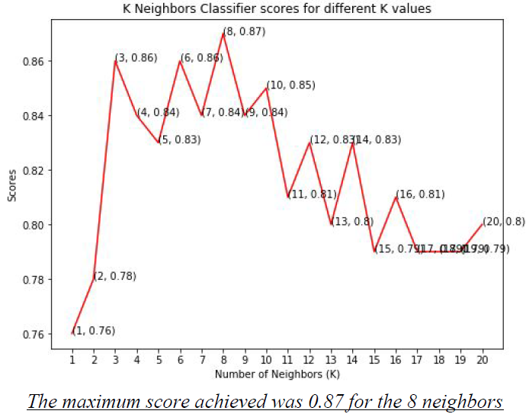
K Nearest Neighbour
The classification score varies based on different values of neighbors that we choose. Thus, I'll plot a score graph for different values of K (neighbors) and check when I will achieve the best score. I have the scores for different neighbor values in the array knn_scores. I'll now plot it and see for which value of K I get the best scores.

Slide 10
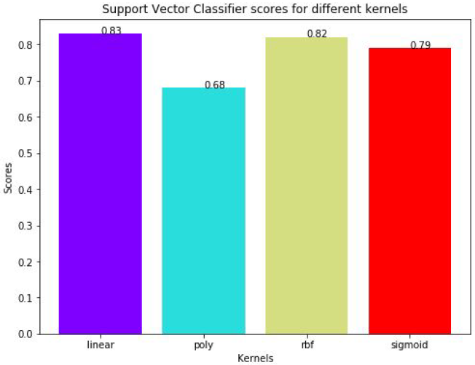
2. Support Vector Classifier Technique
There are several kernels for Support Vector Classifier. I'll test some of
them and check which has the best score. I'll now plot a bar plot of
scores for each kernel and see which performed the best. The score for
Support Vector Classifier is 83.0% with linear kernel.

Slide 11
Results and Analysis
We have predicted the possibility of the presence of heart disease among individuals using their datasets by the methods of K nearest neighbour algorithm (KNN Algorithm) technique and the Support Vector Classifier Technique.
We have found out the different predictions from these two models and have found out that in this particular dataset for heart disease prediction, the KNN approach gives us a higher accuracy of 87% for 8 neighbours compared to the support vector classifier technique which gives us an accuracy of 81%.

Slide 12
Conclusion and Future scope
01
In this project, I used Machine Learning to predict whether a person is suffering from a heart disease. In the end K Neighbors Classifier achieved the highest score of 87% with 8 nearest Neighbors. The results suggest that the proposed approach can significantly improve the learning accuracy.
In future, it would be possible to integrate and ensemble classifiers by reducing the number of parameters and variables for better feature selection. For this purpose, algorithms such as Particle Swarm Optimization (PSO) can be used to improve the classification performance to develop a decision support system for early diagnosis of heart disease.
02

Slide 13
References
[1] Code: https://colab.research.google.com/drive/1PJUIp9GpmFlMA6EdNRoCYw_RjqlvxunQ
[2] https://www.alliedacademies.org/articles/prediction-of-heart-disease-using-knearest-neighbor-and-particle-swarm-optimization.html
[3] https://www.kaggle.com/ronitf/heart-disease-uci
[4]
https://github.com/kb22/Heart-Disease-Prediction/blob/master/Heart%20Disease%20Prediction.ipynb
[5] https://towardsdatascience.com/support-vector-machine-introduction-tomachine-learning-algorithms-934a444fca47
[6] Bishop - Pattern Recognition And Machine Learning -
Springer 2006
[7] Machine-Learning-Tom-Mitchell

Slide 14
Appendix: Code and Sample Data
Medical data mining, Heart disease, KNN, Feature selection, Particle
swarm optimization.
Code:
https://colab.research.google.com/drive/1PJUIp9GpmFlMA6EdNRoCY
w_RjqlvxunQ
Sample data: https://www.kaggle.com/ronitf/heart-disease-uci

Slide 15

Thank you!

